Slide 1



Lecture # 05 ui-controls

Slide 2


Introduction:
UI Controls, also known as Widgets or Views, are the building blocks of an Android app's user interface. They represent various visual elements that allow users to interact with the app and provide input or receive output. Android provides a wide range of UI controls, each designed for specific purposes and functionalities.

Slide 3
Common ui-control
TextView:
Used to display text on the screen.
Can display static or dynamic text.
Supports rich text formatting and styling.
EditText:
Allows users to input and edit text.
Supports various input types like text, numbers, passwords, etc.
Can be configured with input filters and validators.
Button:
Represents a clickable button.
Can be used to trigger actions or navigate to different parts of the app.
Supports different styles and appearances.
CheckBox:
Allows users to make binary choices (true/false, yes/no).
Can be used for selecting multiple options.
Provides a visual indication of the selected state.

Slide 4
Continue:
RadioButton and RadioGroup:
RadioButtons are used for mutually exclusive choices.
RadioGroup groups related RadioButtons together.
Only one RadioButton in a RadioGroup can be selected at a time.
SeekBar:
Allows users to select a value from a continuous range.
Useful for adjusting settings or preferences.
Can be customized with tick marks and a progress indicator.
ImageView:
Displays images in the app.
Supports various image formats (PNG, JPEG, GIF, etc.).
Can be used to display static or dynamic images.

Slide 5
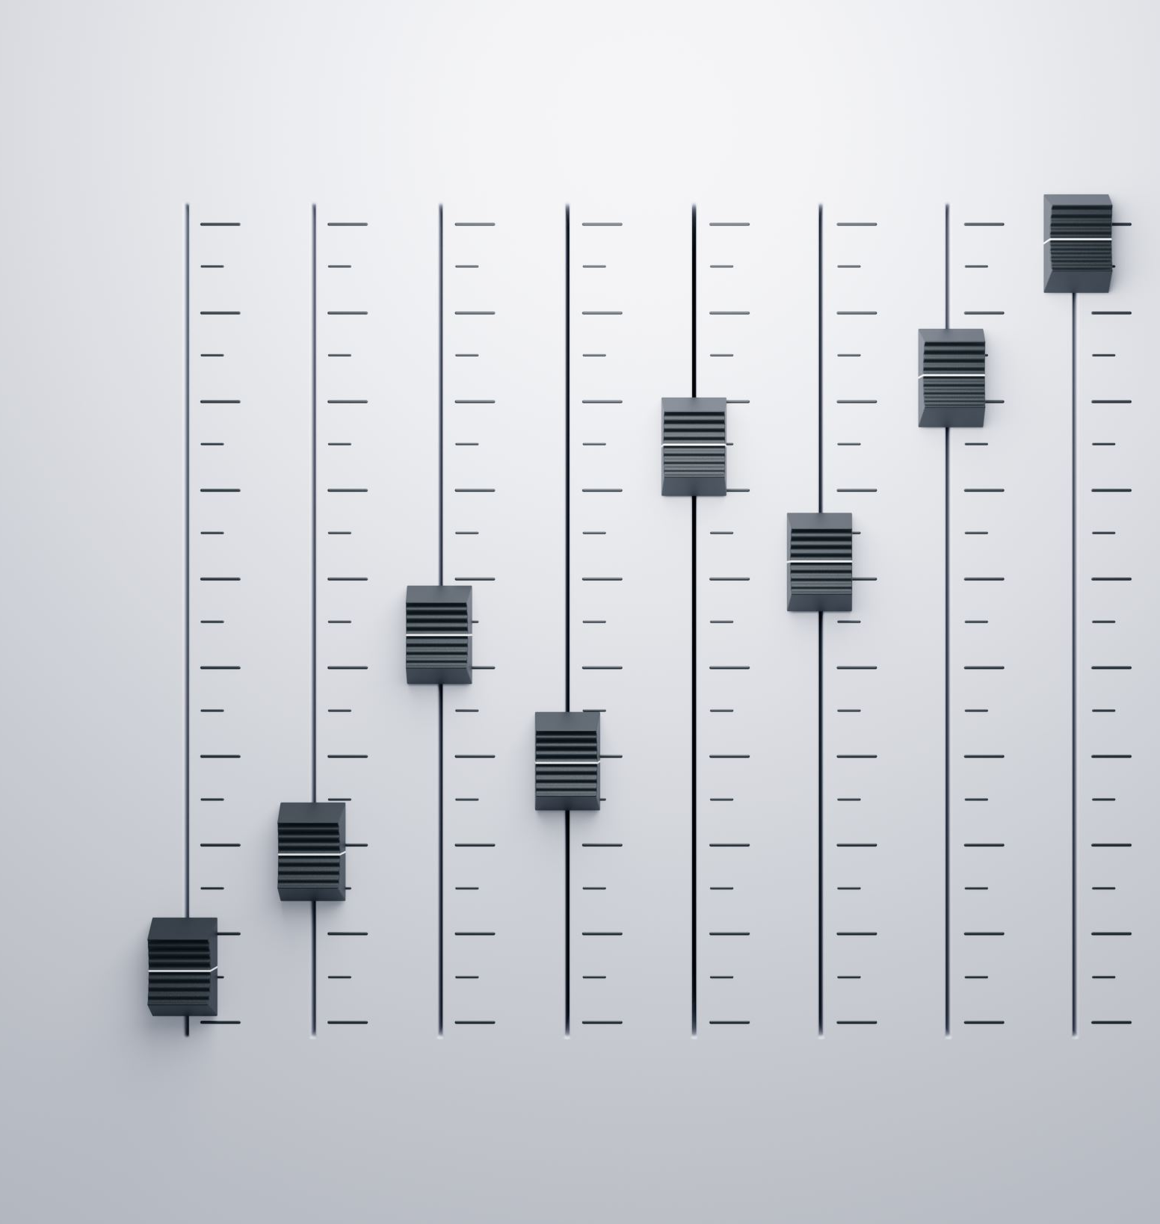

Continue:
Progress Bar:
Indicates the progress of a long-running operation.
Can be displayed as a circular or horizontal bar.
Provides visual feedback to the user during time-consuming tasks.
Switch:
Represents a toggle switch for binary choices.
Provides a more modern and intuitive alternative to CheckBox.
Can be used for enabling/disabling certain app features or settings.

Slide 6
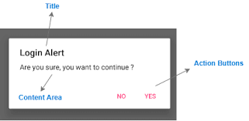
Alert box:
An alert box, also known as an alert dialog, is a UI control in Android that displays a modal dialog box with a message and optional actions for the user to take. Alert boxes are commonly used to convey important information, request user confirmation, or prompt for user input.

Slide 7

Types of alert box:
Types of Alert Boxes:
Alert Dialog: A basic alert box that displays a message and optional action buttons.
Single Choice Dialog: Allows the user to select a single option from a list of choices.
Multiple Choice Dialog: Allows the user to select multiple options from a list of choices.

Slide 8
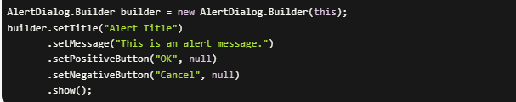
How to add alert box in your application:
Alert boxes are created using the AlertDialog.Builder class.

Slide 9

Handling ui-control events
To make the UI controls interactive and respond to user actions, you need to handle events. Android provides various event listeners and callback methods for different UI controls. For example:
Button: setOnClickListener()
CheckBox: setOnCheckedChangeListener()
RadioGroup: setOnCheckedChangeListener()
SeekBar: setOnSeekBarChangeListener()
EditText: addTextChangedListener()

Slide 10
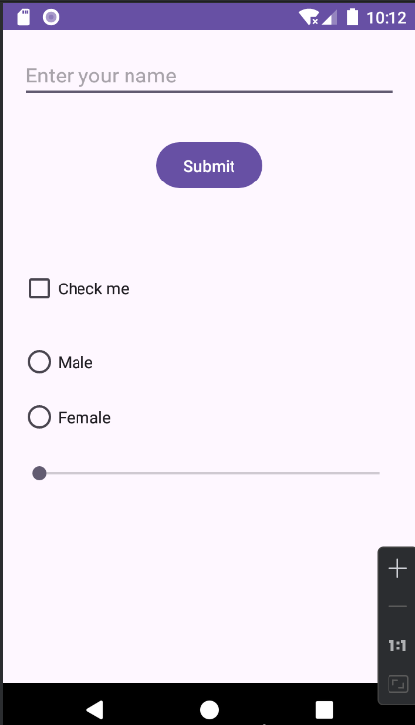
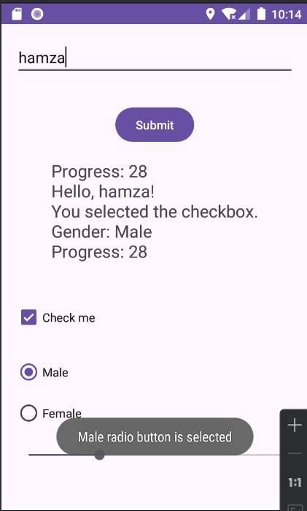
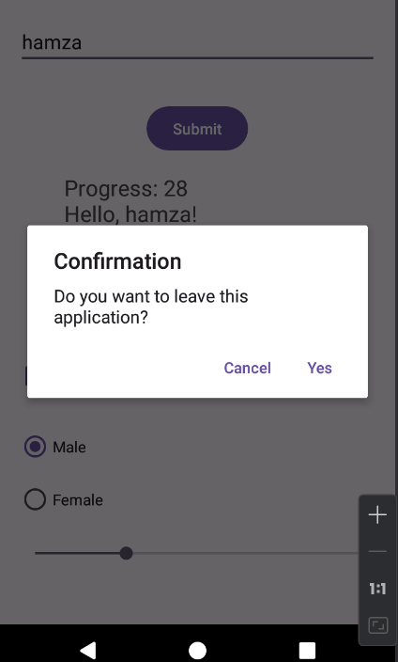
Code example:
Code for this Application present in the Notes Application:
Notes:
package org.hamza.lab_05_ui_controls; import androidx.appcompat.app.AlertDialog; import androidx.appcompat.app.AppCompatActivity; import android.content.DialogInterface; import android.os.Bundle; import android.widget.Button; import android.widget.CheckBox; import android.widget.EditText; import android.widget.RadioButton; import android.widget.RadioGroup; import android.widget.SeekBar; import android.widget.TextView; import android.widget.Toast; public class MainActivity extends AppCompatActivity { EditText editText; Button button; TextView textView; CheckBox checkBox; RadioGroup radioGroup; RadioButton radioButtonMale, radioButtonFemale; SeekBar seekBar; @Override protected void onCreate(Bundle savedInstanceState) { super.onCreate(savedInstanceState); setContentView(R.layout.activity_main); // Initialize UI controls editText = findViewById(R.id.editText); button = findViewById(R.id.button); textView = findViewById(R.id.textView); checkBox = findViewById(R.id.checkBox); radioGroup = findViewById(R.id.radioGroup); radioButtonMale = findViewById(R.id.radioButtonMale); radioButtonFemale = findViewById(R.id.radioButtonFemale); seekBar = findViewById(R.id.seekBar); // Declare and initialize the output variable outside the lambda expression StringBuilder output = new StringBuilder(); // Set click listener for the button button.setOnClickListener(v -> { String text = editText.getText().toString(); // Check if the EditText field is empty if (text.isEmpty()) { // If empty, display a toast message asking the user to fill the form showToast("Please fill the form"); // Clear the output StringBuilder } else { // If not empty, display a toast message indicating successful record save output.append("Hello, ").append(text).append("!\n"); showToast("Record saved successfully"); } // Check if the checkbox is checked if (checkBox.isChecked()) { output.append("You are Graduated.\n"); showToast("Checkbox is checked"); } // Check which radio button is selected int selectedId = radioGroup.getCheckedRadioButtonId(); if (selectedId == radioButtonMale.getId()) { output.append("Gender: Male\n"); showToast("Male radio button is selected"); } else if (selectedId == radioButtonFemale.getId()) { output.append("Gender: Female\n"); showToast("Female radio button is selected"); } // Get the value of the seek bar int progress = seekBar.getProgress(); // Check if the EditText field is not empty if (!editText.getText().toString().isEmpty()) { // Append progress information only if progress is greater than 0 if (progress > 0) { output.append("Progress: ").append(progress).append("\n"); } } // Set the output text to the TextView textView.setText(output.toString()); }); // Set onCheckedChangeListener for CheckBox checkBox.setOnCheckedChangeListener((buttonView, isChecked) -> { if (isChecked) { showToast("Checkbox is checked"); } else { showToast("Checkbox is unchecked"); } }); // Set onCheckedChangeListener for RadioGroup radioGroup.setOnCheckedChangeListener((group, checkedId) -> { if (checkedId == radioButtonMale.getId()) { showToast("Male radio button is selected"); } else if (checkedId == radioButtonFemale.getId()) { showToast("Female radio button is selected"); } }); } // Helper method to show toast messages private void showToast(String message) { Toast.makeText(MainActivity.this, message, Toast.LENGTH_SHORT).show(); } @Override public void onBackPressed() { AlertDialog.Builder builder = new AlertDialog.Builder(this); builder.setTitle("Confirmation") .setMessage("Do you want to leave this application?") .setPositiveButton("Yes", new DialogInterface.OnClickListener() { @Override public void onClick(DialogInterface dialog, int which) { // Close the application finish(); } }) .setNegativeButton("Cancel", new DialogInterface.OnClickListener() { @Override public void onClick(DialogInterface dialog, int which) { // Stay on the application dialog.dismiss(); } }) .show(); } }

Slide 11
Activity.xml
Activity.xml (code in Notes)
Notes:
<?xml version="1.0" encoding="utf-8"?> <RelativeLayout xmlns:android="http://schemas.android.com/apk/res/android" xmlns:tools="http://schemas.android.com/tools" android:layout_width="match_parent" android:layout_height="match_parent" tools:context=".MainActivity"> <EditText android:id="@+id/editText" android:layout_width="match_parent" android:layout_height="wrap_content" android:hint="Enter your name" android:layout_margin="16dp"/> <Button android:id="@+id/button" android:layout_width="wrap_content" android:layout_height="wrap_content" android:layout_below="@id/editText" android:layout_centerHorizontal="true" android:text="Submit" android:layout_marginTop="16dp"/> <TextView android:id="@+id/textView" android:layout_width="wrap_content" android:layout_height="wrap_content" android:layout_below="@id/button" android:layout_centerHorizontal="true" android:textSize="20sp" android:layout_marginTop="16dp"/> <CheckBox android:id="@+id/checkBox" android:layout_width="wrap_content" android:layout_height="wrap_content" android:text="Check me" android:layout_below="@id/textView" android:layout_marginTop="16dp" android:layout_marginStart="16dp"/> <RadioGroup android:id="@+id/radioGroup" android:layout_width="wrap_content" android:layout_height="wrap_content" android:layout_below="@id/checkBox" android:layout_marginTop="16dp" android:layout_marginStart="16dp"> <RadioButton android:id="@+id/radioButtonMale" android:layout_width="wrap_content" android:layout_height="wrap_content" android:text="Male"/> <RadioButton android:id="@+id/radioButtonFemale" android:layout_width="wrap_content" android:layout_height="wrap_content" android:text="Female"/> </RadioGroup> <SeekBar android:id="@+id/seekBar" android:layout_width="match_parent" android:layout_height="wrap_content" android:layout_below="@id/radioGroup" android:layout_marginTop="16dp" android:layout_marginStart="16dp" android:layout_marginEnd="16dp"/> </RelativeLayout>

Slide 12
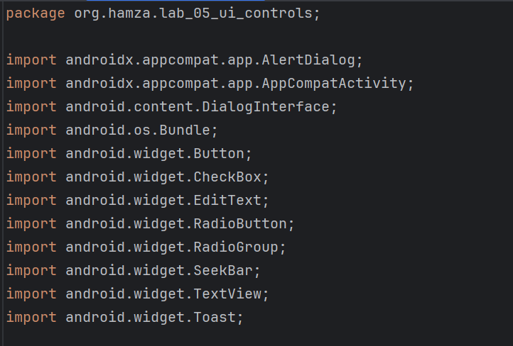
IMPORTS:

Slide 13
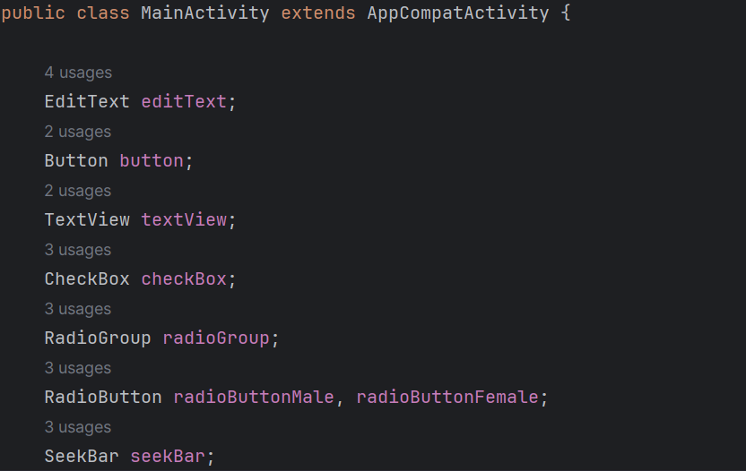
DECLARING INSTANCES:

Slide 14
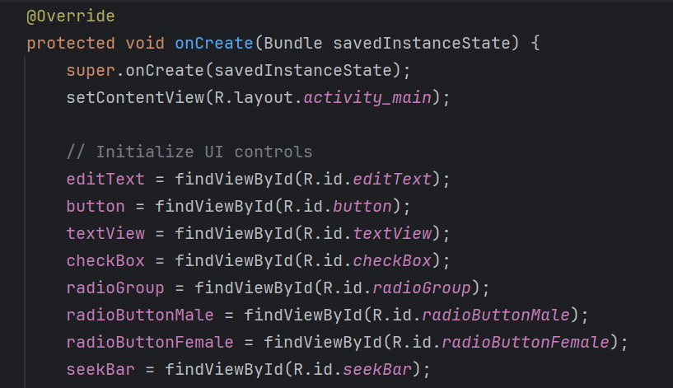
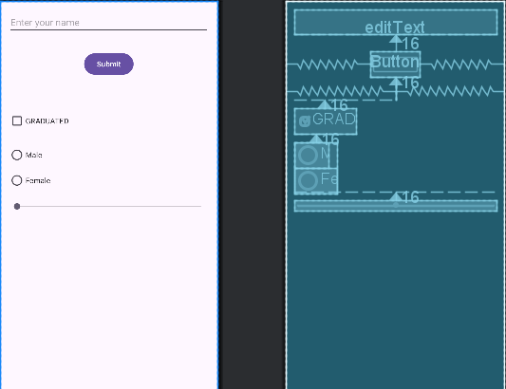
SET UI RESOURCE FILE AND DECLARE UI COMPONENT BY ITS ID

Slide 15
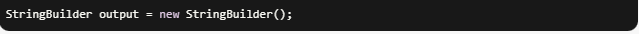
STRING BUILDER FOR STRING MANIPULATION OPERATION
This line declares a variable named output of type StringBuilder and initializes it with a new instance of the StringBuilder class.
The StringBuilder class is part of the Java standard library (java.lang package) and is designed for efficient string manipulation operations, such as concatenation, appending, inserting, and deleting characters or strings.

Slide 16
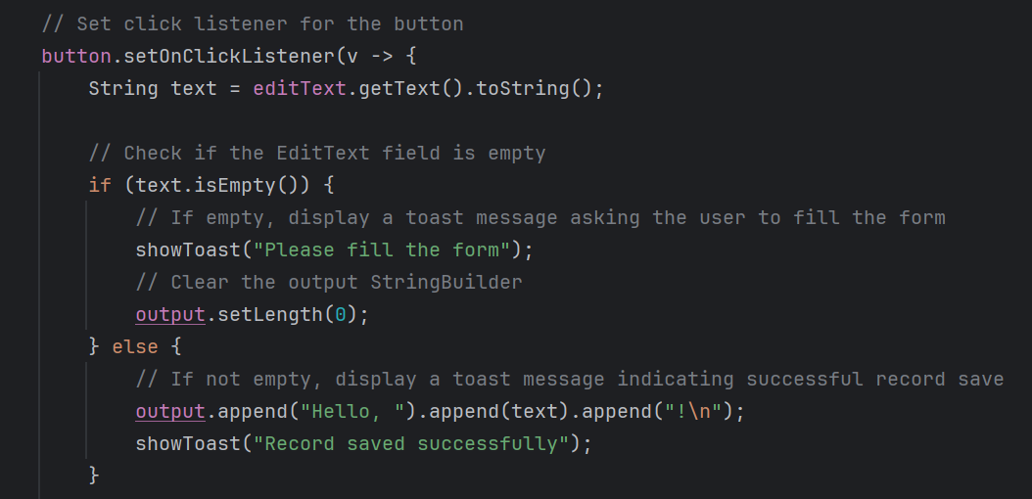

EDIT TEXT IMPLEMENTATION :

Slide 17
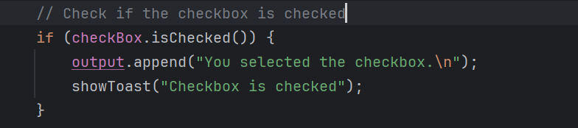
CHECK BOX IMPLEMENTATION

Slide 18
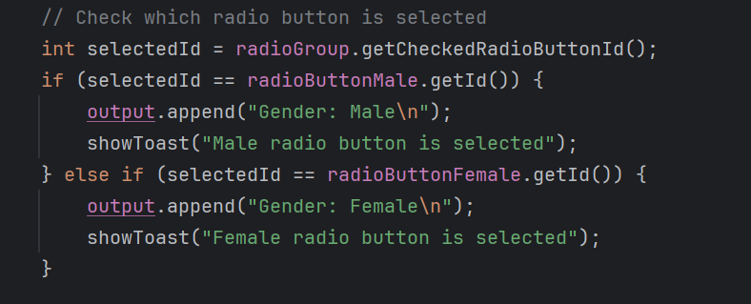
RADIO GROUP & RADIO BUTTON IMPLEMENTATION

Slide 19
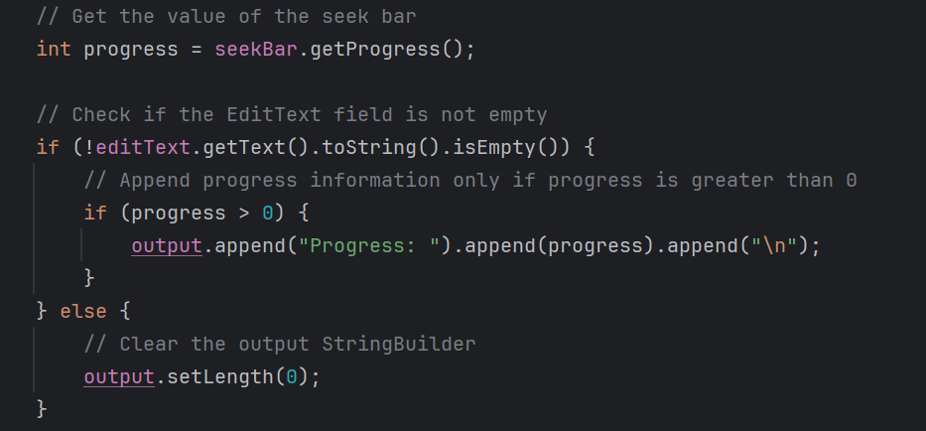
SEEK BAR IMPLEMENTATION:

Slide 20

SHOW WHATEVER APPEND TO THE OUTPUT VARIABLE OF STRING BUILDER

Slide 21
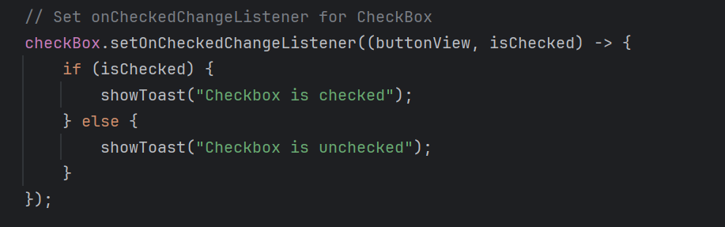
CHECKBOX EVENT HANDLING : (toast message)

Slide 22
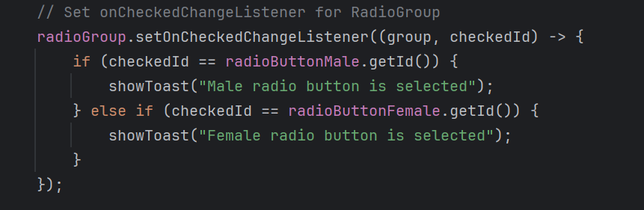
RADIO BUTTON EVENT HANDLING: (toast message)

Slide 23
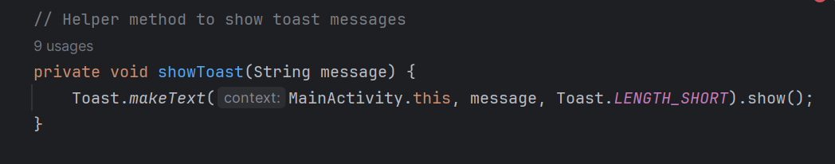
HELPER METHOD TO SHOW TOAST MESSAGES

Slide 24
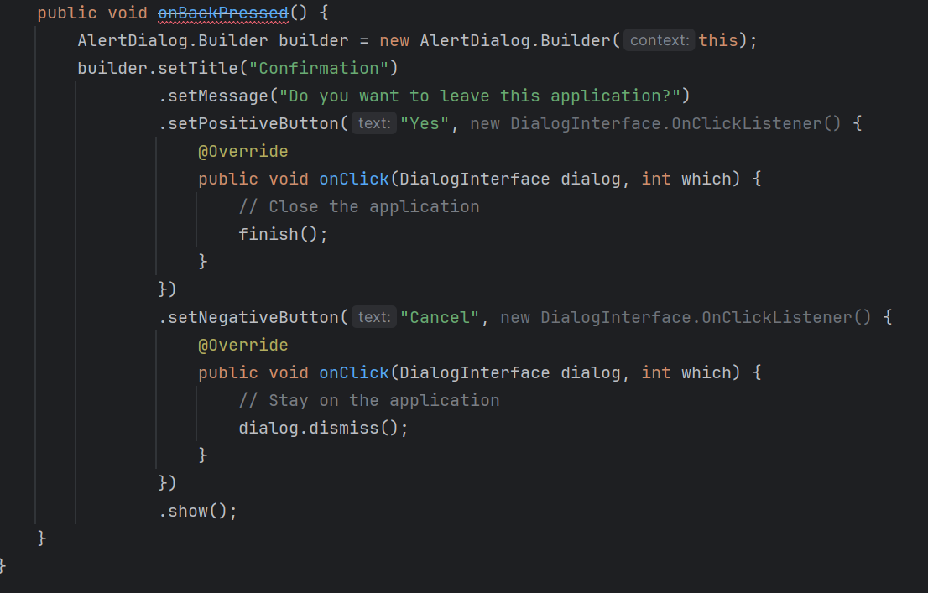
ALERT BOX IMPLEMENTAION

Slide 25

Dialogue interface description:
DialogInterface is an interface in Android that represents a dialog interface. It is used to define the methods that handle user interactions with a dialog.
the onClick() method which is called when a button in the dialog is clicked.
The onClick() method is called with two parameters:
dialog: The dialog that received the click event.
which: An integer representing the button that was clicked. It can be DialogInterface.BUTTON_POSITIVE for the positive button (in this case, "Yes") or DialogInterface.BUTTON_NEGATIVE for the negative button (in this case, "Cancel").

Slide 26
Task 1:
Task 1: Simple Registration Form
Create a simple registration form using the following UI controls:
EditText for entering the user's name, email, and password.
RadioGroup with RadioButton for selecting the user's gender.
CheckBox for accepting the terms and conditions.
Button for submitting the form.
When the user clicks the submit button, validate the input fields and display a Toast message or an AlertDialog indicating whether the registration was successful or if any fields were left empty or invalid.

Slide 27
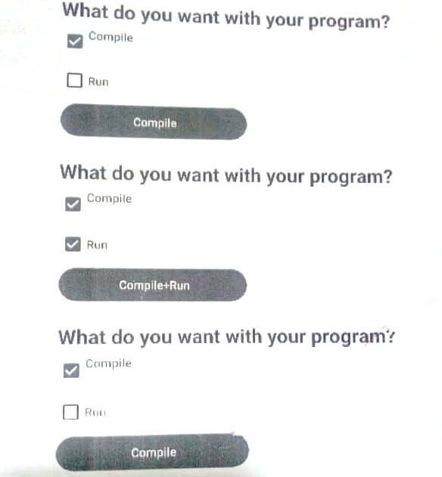
Task 2:
Taking Composite choice from the user using checkbox

